Slide 1
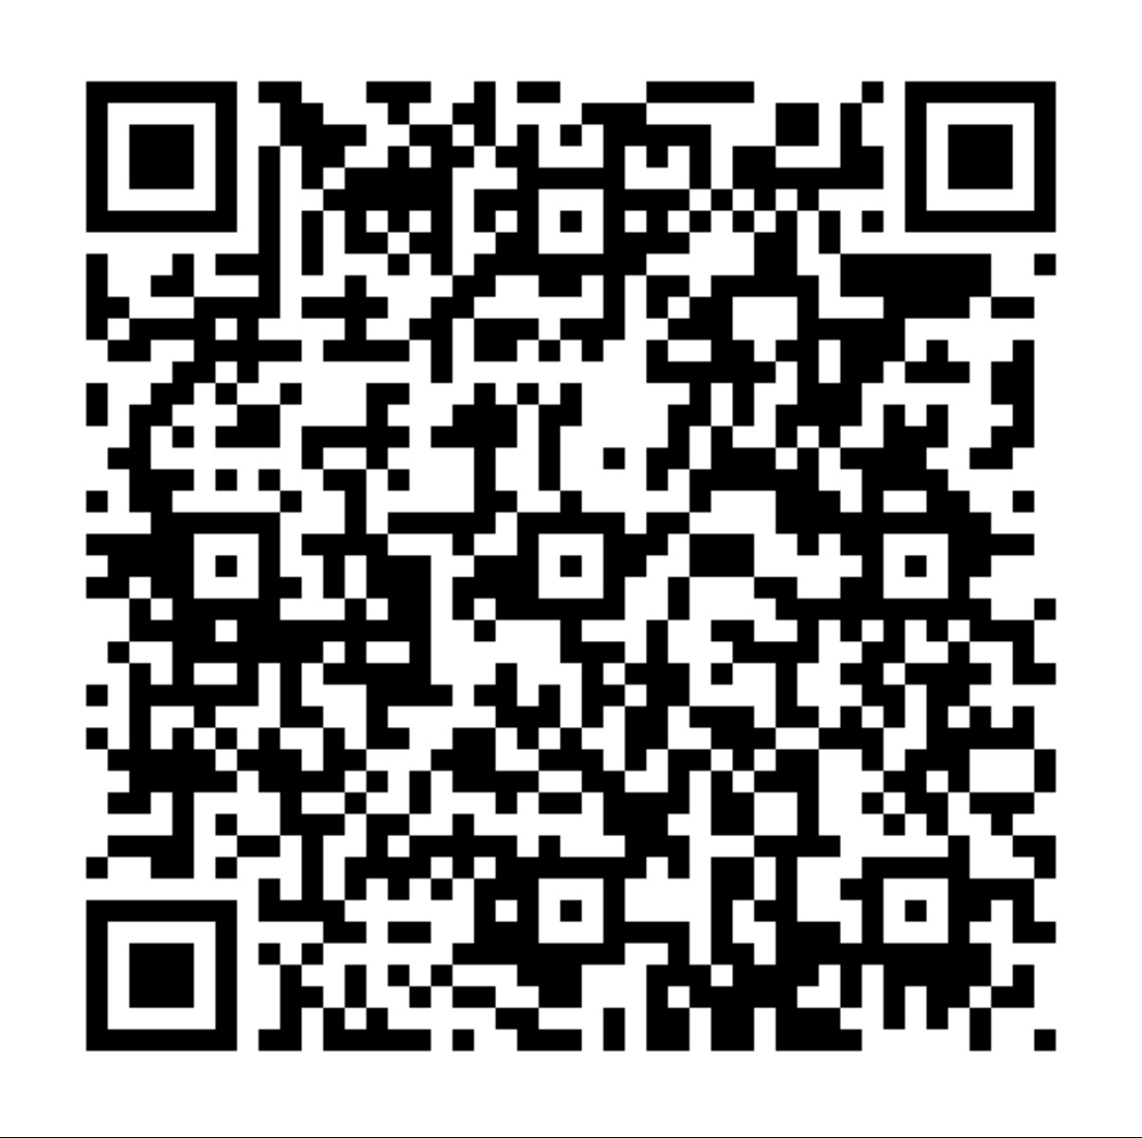
FOCUS GROUP DISCUSSION QUESTIONS FOR EXPERTS FROM THE MINISTRY OF EDUCATION
Responder Link :
https://docs.google.com/forms/d/e/1FAIpQLSebG6eLfVAM99DwQOKNG-3Nb8d1vYRilop6Fq-ECcg6yoT2Ng/viewform?usp=sharing

Slide 2
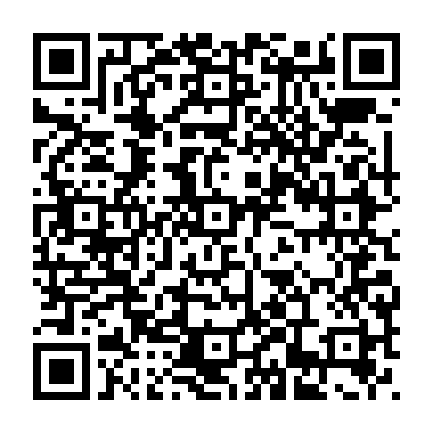
(USAT FOR TEACHER EDUCATORS) ASSESSING ESD LEADERSHIP STATUS IN TEACHER EDUCATION INSTITUTIONS IN SUB-SAHARAN AFRICA
Responder Link :
https://docs.google.com/forms/d/e/1FAIpQLSfNSKURCRqra9uj5hTOQEHrGuELUguUk7Zlz7z9-ShbXW7pkw/viewform?usp=sharing

Slide 3
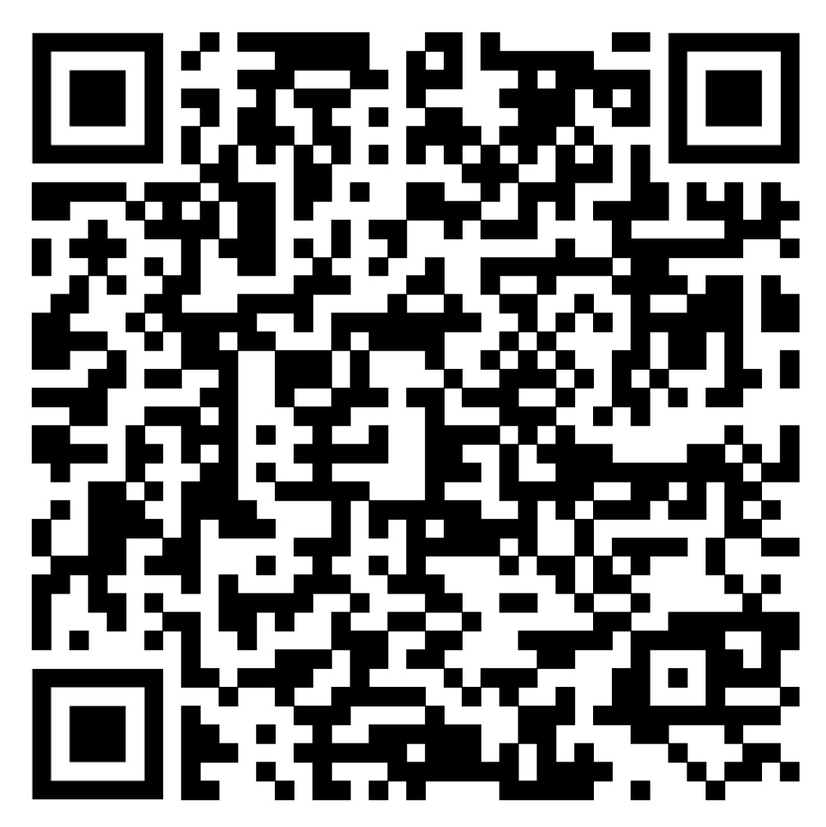
(USAT FOR STUDENT TEACHER) ASSESSING ESD LEADERSHIP STATUS FOR THE SUSTAINABILITY STARTS WITH TEACHER LEADERS PROJECT
Responder Link :
https://docs.google.com/forms/d/e/1FAIpQLSdVA-QWI6r1i_az55qFiCMOT0d_rUgllhZRb5eX3aWGiSqxQA/viewform?usp=sharing

Slide 4
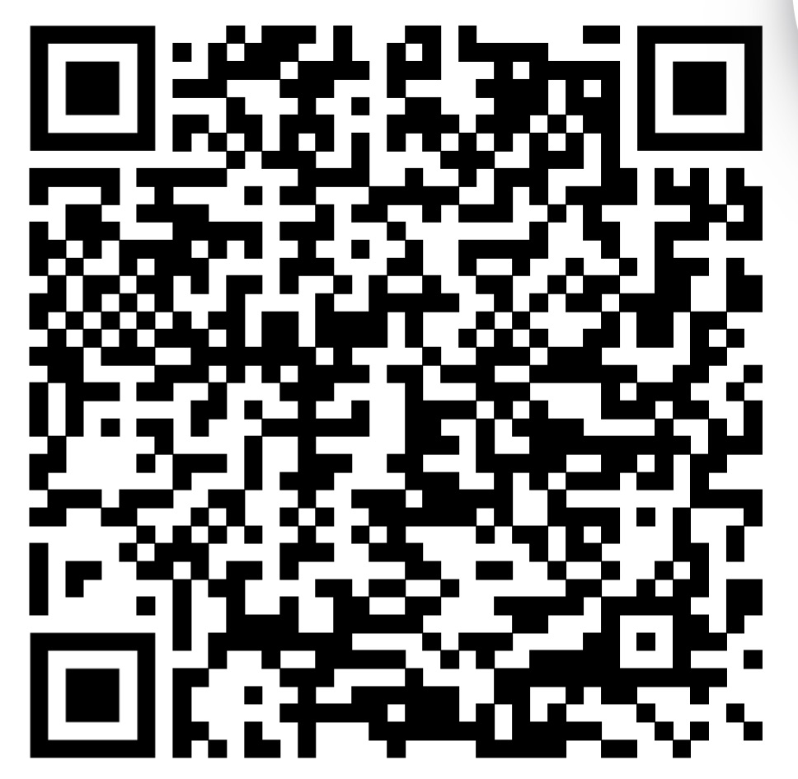
FGD Guide for Administrators of Teacher Education Institutions
Responder Link :
https://docs.google.com/forms/d/e/1FAIpQLSfyBNQCr7Z4reGYIYGaEBKxot94nCkTD0qWTNuI3e9_Ht-hJA/viewform?usp=sharing

Slide 5
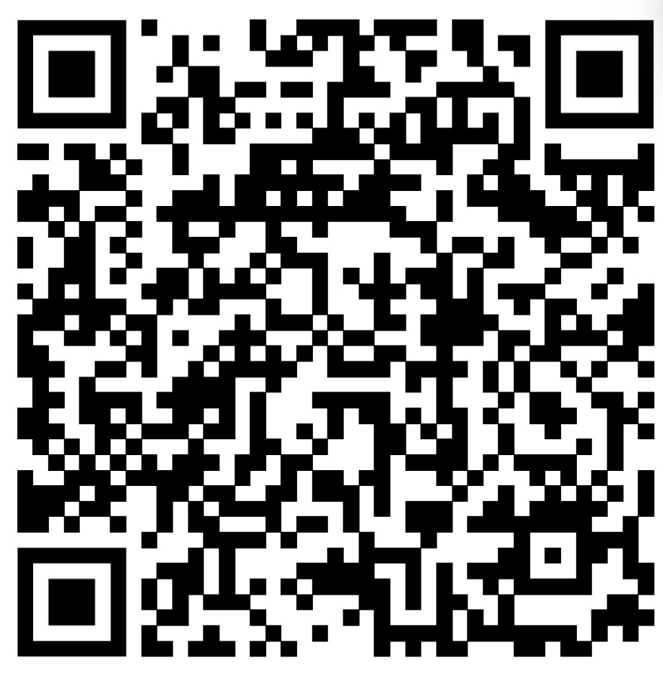
STAKEHOLDER ANALYSIS FOR SUSTAINABILITY STARTS WITH TEACHER LEADERS PROJECT
Responder Link :
https://docs.google.com/forms/d/e/1FAIpQLSdz3-0ro_QTN3Or-31-B6PfBSe0yH0YnZifsekAPGf7xGOScw/viewform?usp=sharing

